Slide 1
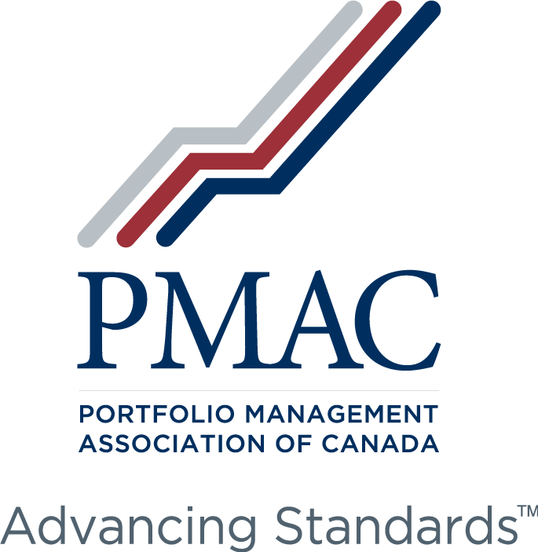


Slide 2


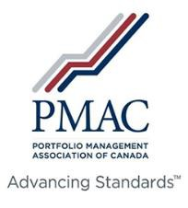


Law 25 Update
by Eugen Miscoi
December 5, 2023

Slide 3


Agenda
Overview of the Canadian Privacy Law Landscape
Law 25 – A Brief Overview
Recent Trends and Developments
mccarthy.ca | McCarthy Tétrault LLP

Slide 4


































Canadian Landscape: Private Sector Privacy
Canada (except AB, BC, QC)
Quebec
Personal Information Protection and Electronic Documents Act
Act respecting the protection of personal information in the private sector (as amended by Law 25)
British Columbia
Personal Information Protection Act
Alberta
Personal Information Protection Act
3
mccarthy.ca | McCarthy Tétrault LLP

Slide 5




Law 25
Brief Overview
Chief Privacy
Officer
Breach Notification Requirements*
Breach
Register
2022
Biometrics*
Privacy Governance Framework
Privacy by Design & PIAs*
New Rules for Consent (e.g., Children)
Disposition of Data*
New Customer Rights
Significant Sanctions*
2023
2024
Right to Data Portability
4
* Areas of high risk.
mccarthy.ca | McCarthy Tétrault LLP

Slide 6
Recent Developments
Law 25
List of organizations that declared a « Confidentiality Incident » to the CAI between September 2022 and October 2023
  List of organizations that declared a « Confidentiality Incident » to the CAI between September 2022 and October 2023: https://www.cai.gouv.qc.ca/documents/CAI_incidents_declares_sept_2022_oct_2023.pdf
Privacy Impact Assessments:
  PIA Guidelines: https://www.cai.gouv.qc.ca/documents/CAI_Guide_EFVP_FR.pdf
  PIA Template: https://www.cai.gouv.qc.ca/documents/GAB_Rapport_EFVP.docx
Consent:
  Guidelines on the validity of consent: https://www.cai.gouv.qc.ca/documents/CAI_LD_Criteres_validite_consentement.pdf
5
mccarthy.ca | McCarthy Tétrault LLP

Slide 7



Questions?
emiscoi@mccarthy.ca

Slide 9
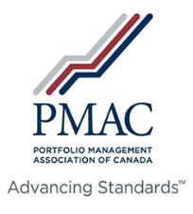
2023-2024 Compliance Priorities for Portfolio Managers: KYC, KYP and Suitability
Sonia Struthers and Cristian O. Blidariu
McCarthy Tétrault LLP
December 6, 2023

Slide 10
Client Focused Reforms (CFRs)
Significant regulatory initiative based on the concept that in the client-registrant relationship, the interests of the client come first
Came into effect December 31, 2021
Affects many key aspects of compliance and operations, including
  conflicts of interest
  know your product (KYP)
  know your client (KYC)
  suitability

Slide 11
Expanded “Know Your Client” Requirements
13.2(2)(c) – expands the list of KYC information that must be collected by registrants in order for them to understand their clients well enough to meet their suitability determination obligations. The additional information required under the CFRs includes the client’s:
  personal circumstances (not limited to financial circumstances),
  investment knowledge,
  risk profile (guidance clarifies that this includes both the client’s risk tolerance and their risk capacity),
  investment time horizon

Slide 12
Expanded “Know Your Client” Requirements
13.2(3.1) – new subsection requiring registrants to take reasonable steps to obtain clients’ confirmation of the accuracy of their KYC information.
13.2(4) – expands requirement to keep KYC information current to expressly require updating the client’s information if the registrant become aware of a significant change.

Slide 13
Expanded “Know Your Client” Requirements
13.2(4.1) – new subsection specifying minimum intervals when a client’s KYC information must be reviewed:
  12 months for managed accounts;
  12 months before making a trade or recommendation for exempt market dealers;
  36 months for other cases.

Slide 14
Expanded “Know Your Client” Requirements
New guidance in the Companion Policy discusses, among other things,
  the ways a registrant may tailor its KYC process to reflect its business model and the nature of its relationships with clients,
  using technology for the collection of KYC information, and
  CSA expectations with respect to the KYC information that must be collected by registrants to meet the requirements on an ongoing basis.

Slide 15
Express “Know Your Product” Requirements
express KYP requirement introduced in new section 13.2.1
  Like the enhanced KYC requirements, this is intended to support an enhanced suitability determination obligation
13.2.1(1) – obligation of registered firms to take reasonable steps to ensure that the securities that they make available to clients are
  assessed with regard to their relevant aspects, including for their structure, features, risks, initial and ongoing costs, and the impact of those costs,
  approved to be made available to clients
  monitored for significant changes

Slide 16
Express “Know Your Product” Requirements
13.2.1(2) – obligations of registered individuals to take reasonable steps to understand the securities that they purchase, sell or recommend to a client, including the impact of the initial and ongoing costs associated with acquiring and holding each security, sufficient to enable them to make a suitability determination.
13.2.1(3) – registered individuals must only purchase or recommend securities approved by their firm to be made available to clients.

Slide 17
Express “Know Your Product” Requirements
The Companion Policy codifies CSA’s KYP expectations of firms and registrants as set out in previous CSA and SRO guidance. It also sets out CSA’s views on how firms can tailor their processes for meeting the KYP obligation depending on
  a firm’s business model,
  a security’s type
  whether other registrants are also involved in a security’s distribution to the client
  whether a security is being transferred in

Slide 18
Expanded Suitability Requirements
The CFRs enhance the suitability determination obligation in section 13.3 with, among other things, a new core requirement that registrants must put their clients’ interests first when making a suitability determination.

Slide 19
Expanded Suitability Requirements
13.3(1) – before a registrant opens an account for a client, purchases, sells, deposits, exchanges or transfers securities for a client’s account, takes any other investment action for a client, or makes a recommendation or exercises discretion to take any such action, the registrant must determine, on a reasonable basis, that:
  1. the action puts the client’s interest first

Slide 20
Expanded Suitability Requirements (Cont’d)
2. the action is suitable for the client, based on the following factors:
  KYC information;
  the registrant’s assessment or understanding of the security;
  the impact of the action on the account, including its concentration and liquidity;
  the actual and potential impact of costs on the client’s returns;
  a reasonable range of alternatives available through the firm at the time the determination is made

Slide 21
Expanded Suitability Requirements
13.3(2) – new subsection prescribing trigger events that require registrants to review a client’s account and the securities in the account in accordance with subsection 13.3(1) and take appropriate action, within a reasonable time, in the following circumstances:
  a registered individual is designated as responsible for the client’s account;
  the registrant becomes aware of a change in a security in the account, or becomes aware of a change in the client’s KYC information, that could result in the security or account not satisfying the suitability determination criteria;
  the registrant has undertaken a review of the client’s KYC information.

Slide 22
Expanded Suitability Requirements
13.3(2.1) – new subsection for client-directed trades
New guidance in the Companion Policy sets out CSA’s expectations as to how registrants may meet their enhanced suitability obligations.
  If CSA reviews a suitability determination made by a registrant, they will do so without hindsight and on the basis of what a reasonable registrant would have done under the same circumstances.

Slide 23
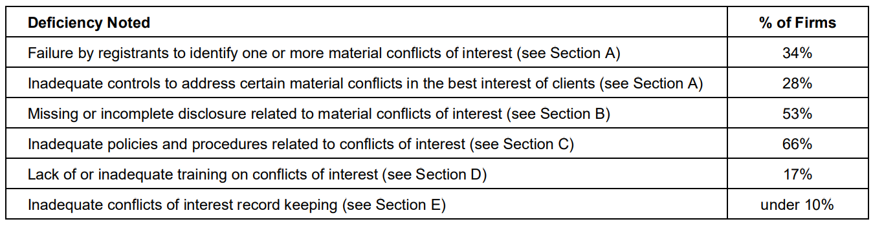
What May Come Next
The CFRs included significant conflicts of interest reforms which came into effect June 2021.
CSA recently concluded a review of firms’ conflicts of interest practices (including those of 72 portfolio manager firms) and published its findings

Slide 24
What May Come Next
Similar CSA sweeps were announced with respect to KYC, KYP and suitability:
  “We will continue to review and evaluate firms’ compliance with securities legislation, including all CFR requirements during regular compliance examinations and will use all tools available along the compliance enforcement continuum to address any noncompliance. The CSA and CIRO will conduct reviews in 2023 to specifically assess registrants’ compliance with other CFRs obligations, including the know your client, know your product and suitability determination requirements that came into force on December 31, 2021.”

Slide 25
Preparing for KYC, KYP and Suitability Compliance Sweeps
Onboarding procedures including opening of account documents
  KYC
    Cannot be delegated by registered firm
    Requires meaningful interaction (standardized questionnaire may be used but registrant remains responsible)
    Appropriate level of information (increased detail both for individuals eg all type of assets and liabilities even held outside of registrant, entities)
    How subjective elements such as investment time horizon, investment objectives, risk profile established: eg. self-assessment questionnaire
    Necessary information if prospectus exemption (ie accredited investor) used
    Resolution of conflicts between a client’s expectations & risk profile

Slide 26
Preparing for KYC, KYP and Suitability Compliance Sweeps
Training
  For registered individuals:
    New Suitability procedures
      Conflicts of interest between individual and client
      Implementing best interest of client when material conflict of interest
      Portfolio approach to suitability
      Cannot be delegated by registered individual to firm personnel
    New KYC procedures including onboarding, updating & supervision
    New KYP procedures
      If no shelf list, how the registered individuals assess securities
      How to asses structure, features and risks of types and particular securities offered and costs (firm expected to provide relevant information)

Slide 27
Preparing for KYC, KYP and Suitability Compliance Sweeps
Record keeping
Compliance Manual (gap analysis)
  KYC
  KYP
  Suitability
  Conflicts of Interest
    Client best interest
    Proprietary products
    Third party remuneration

Slide 28
Thank you.
Sonia Struthers
Cristian O. Blidariu
sstruthers@mccarthy.ca
514-397-4232
cblidariu@mccarthy.ca
416-601-8156

Slide 31
Referral Arrangements:
Compliance and Enforcement Risks
Sean D. Sadler and Shane C. D’Souza, with assistance from Aya Fahimi
McCarthy Tétrault LLP
December 6, 2023

Slide 32
Key Elements of the Referral Arrangement
“Referral Arrangement” means any arrangement in which a registrant agrees to provide or receive a referral fee to or from another person or company;
“Referral Fee” means any monetary or non-monetary benefit provided for the referral of a client to or from a registrant;
“Referrals in” - clients are referred by the registrant from another party;
“Referral out” - clients are referred by the registrant to another party.
National Instrument 31-103 s.13.7

Slide 33
Key Benefits of Referral Arrangements
Referral arrangements are an important means of:
building a registrant business
facilitating succession planning
helping clients obtain relevant services from third or related parties

Slide 34
Key Regulatory Risks for Referral Arrangement
failing to comply with NI 31-103 referral arrangement provisions or similar regulatory requirements
failing to properly identify and address the conflicts of interest presented by the referral arrangement in the best interest of the client
permitting registrable activity to be performed by non-registrants (e.g., KYC collection or advising in securities)
inappropriate ratio of advising representatives to clients
failing to comply with section 11.9 of NI 31-103

Slide 35
Framing Disclosure to Clients
Referral Agreement – parties, purpose and material terms
Conflicts of Interest
Calculation and Amount of Referral Fee
Categories of Registration of the Registrant and activities they’re allowed to engage in
Any other information that would be expected by a reasonable investor
Disclosure of any subsequent change to the Referral Agreement
Statement that all registerable activities will be conducted by the registrant

Slide 36
Framing Disclosure to Clients (contd.)
Client disclosure should help the client understand:
the entity they are dealing with and what they can expect from that entity
the registrant’s responsibilities towards them
the extent of referring party’s financial interest in the Referral Agreement
the nature of existing and reasonably foreseeable conflicts of interest.

Slide 37
Regulatory Red Flags
continued involvement of referring party in the client relationship
excessive compensation to referring party
trailing compensation to referring party without reasonable basis
inadequate resources/infrastructure to properly serve the volume of new clients
confusion by client as to “who is their adviser?”

Slide 38
Enforcement Matters
Upfront compliant process and contemporaneous documentation can assist in investigation process and lower risk of conflicting evidence from interviews
Permanent prohibition or lengthy suspension not uncommon
Thong (Re), MFDA File No. 201668 (2016)
Oosterveld (Re), MFDA File No 201514 (2016)
Re Kendrick, 2018 CanLII 65335 (CA MFDAC)
Re Liu, 2018 BCSECCOM 372
Re Liu, 2019 BCSECCOM 236
Factors that may be considered
- Magnitude (in size and value) of referrals
- Number of clients affected
- Magnitude of client losses (if any)
- Existence of client complaints
- Suitability of referrals if involving securities
- Compensation received
- Any personal interest of the respondent in referral

Slide 39
Civil liability
Same theory as other suitability / supervisory cases
Facts may be pitched as “no one was really looking after client’s best interests”
Damages may be hard to prove unless there is a suitability issue, but investor could seek disgorgement of fees

Slide 40
Implementing a Compliant Referral Arrangement
before implementing a referral arrangement, consult with CCO and legal counsel and if an IFM, the IRC
prepare a “tailored” referral agreement (avoid “template”) with detailed covenants as do’s and don’ts for the parties to follow
prepare policies and procedures/internal controls tailored to proposed referral arrangement
conduct conflict of interest assessment and address conflict in a manner that is in the client’s best interest

Slide 41
Implementing a Compliant Referral Arrangement (contd.)
for referrals out, conduct due diligence on the party receiving the referral
make appropriate client disclosures
prepare internal and external education or “guardrail” documents to ensure staff and referral agents comply with requirements
monitor compliance regularly – is your firm and referral counterparty doing what is required of them?
consider seeking annual attestation from referral agent re compliance with contractual stipulations
have CCO report annually to the board on the referral arrangement

Slide 42
Thank you.
Sean D. Sadler
Shane C. D’Souza
ssadler@mccarthy.ca
416-601-7511
sdsouza@mccarthy.ca
416-601-8196

Slide 45
Breakout Rooms
Conflict of Interest findings Staff Notice
Client Focused Reforms/other compliance
Registration information changes
Human resources management

